Slide 1





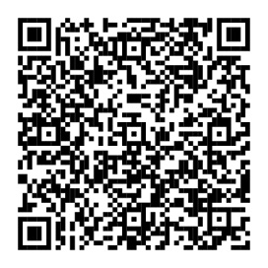
Your benefits can help you focus
on what matters.
There’s a lot to think about when you’re planning to start a family and when you bring a new baby home. To help you with everything from planning to welcoming home and raising your new baby, you have access to a benefits checklist. It can help you understand what benefits are available to
you and how they can help.
Planning for
baby
Bringing home
baby
Raising a family
This section of your checklist can help you keep track of things like finding family planning options or understanding how to initiate your
family leave.
With so much to manage and so little time to
sleep, let this section
help with everything
from updating your
health benefits to finding breastfeeding support.
This part can help you
act on time-sensitive
items, like adding a
new beneficiary to your benefits or starting a savings plan for your child’s future.
Scan QR code or visit NetBenefits.com/Parenthood to see your personalized checklist.
Fidelity and the Fidelity Investments logo are registered service marks of FMR LLC.
Fidelity Workplace Services LLC, 245 Summer Street, Boston, MA 02210
© 2025 FMR LLC. All rights reserved. 1241645.1.0
CLIENT LOGO

